Slide 1
Fabric Network
Runtime Architecture
2020.12

Slide 2
Content
Architecture Overview
Component
Relationship
Conclusion

Slide 3
Part 1: Architecture Overview

Slide 4
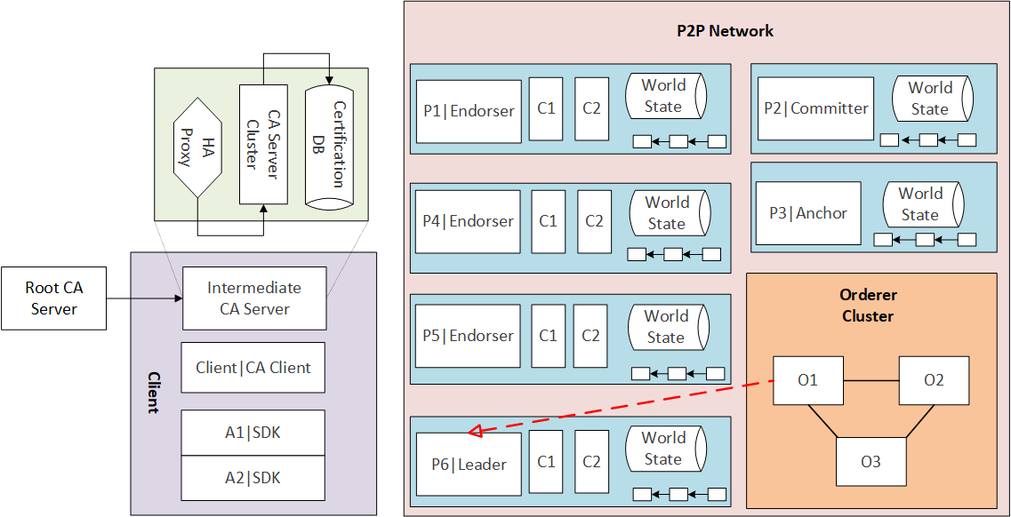
Architecture Overview

Slide 5
Part 2: Component

Slide 6
Component
Peer
Orderer
CA
Client

Slide 7
1. Peer

Slide 8
2. Orderer

Slide 9
3. CA

Slide 10
4. Client

Slide 11
Part 3: Relationship

Slide 12
Relationship
Channel
Organization
Cluster

Slide 13
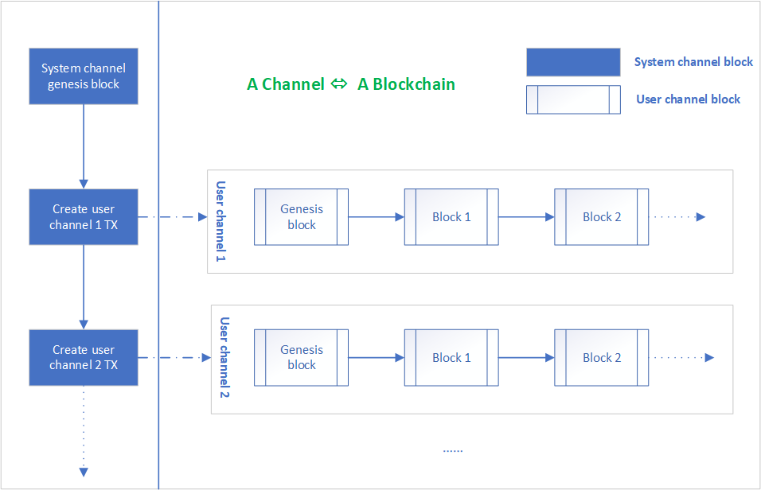
1. Channel

Slide 14
2. Organization

Slide 15
3. Cluster

Slide 16
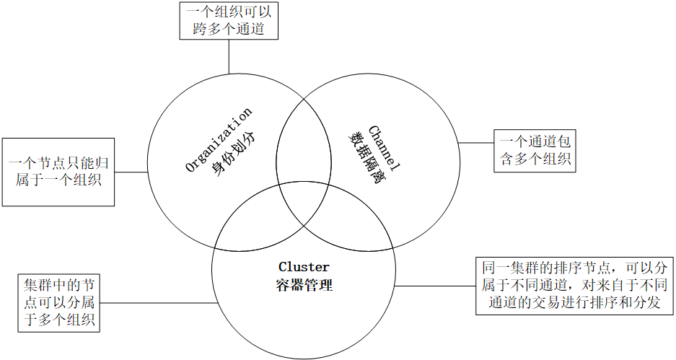

Slide 17
Part 4: Conclusion

